Slide 1

Pitch deck
Mirjam Nilsson​

Slide 2

Project Topic
Exploring the Dominant Industries Shaping Billionaire Wealth

Slide 3
INTRODUCTION & OBJECTIVE
Understanding which industries have a major influence on billionaire wealth and can offer insights into economic growth.
Let's embark on this journey to uncover the industries that shape the fortunes of the world's billionaires.

Slide 4

Understanding Billionaire Landscape
Before we dive into industry analysis, let's take a glimpse at our dataset's scope. We've collected data on 2,654 billionaires from various countries.

Slide 5
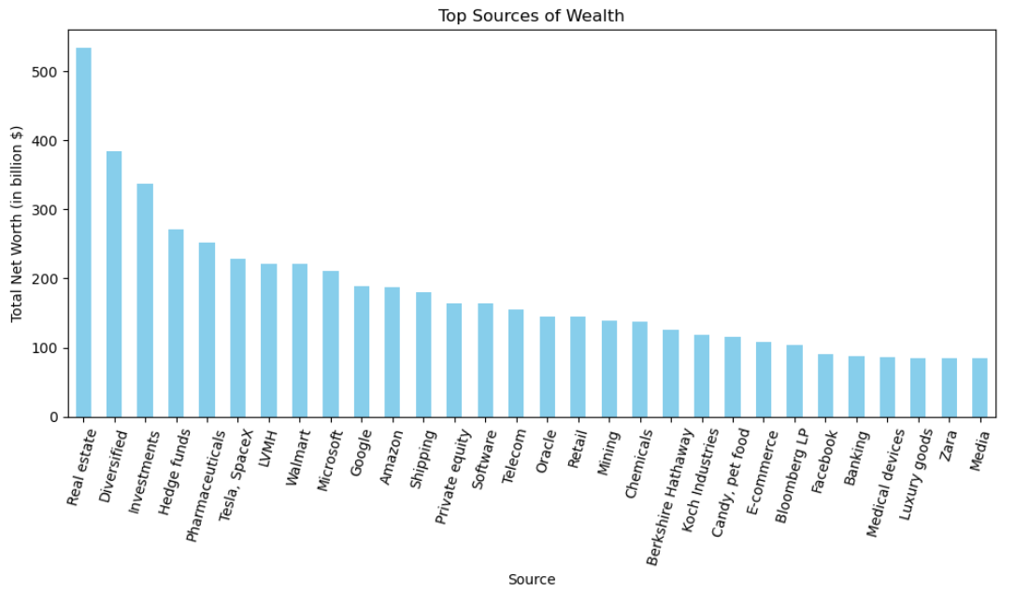
Top Sources of Wealth
The sources of billionaire wealth are diverse and span multiple industries.

Slide 6
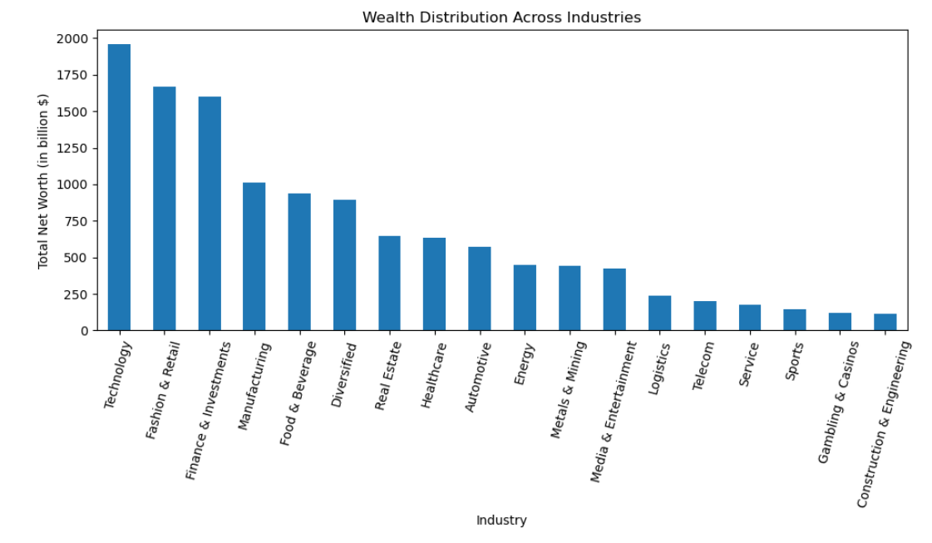
Wealth Distribution Across Industries
The distribution pattern highlights the diverse economic impact of various sectors.
Understanding industry-wise wealth distribution provides insights into global economic dynamics.

Slide 7
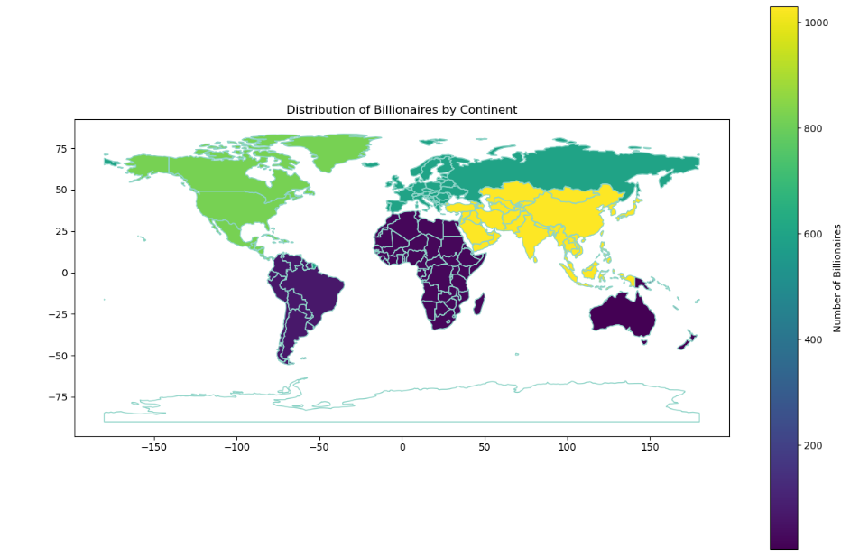
Wealth Distribution by Continent
Geographical location plays a significant role in wealth distribution among billionaires.
The distribution of wealth by continent reflects economic development, industry dominance, and regional economic dynamics.

Slide 8
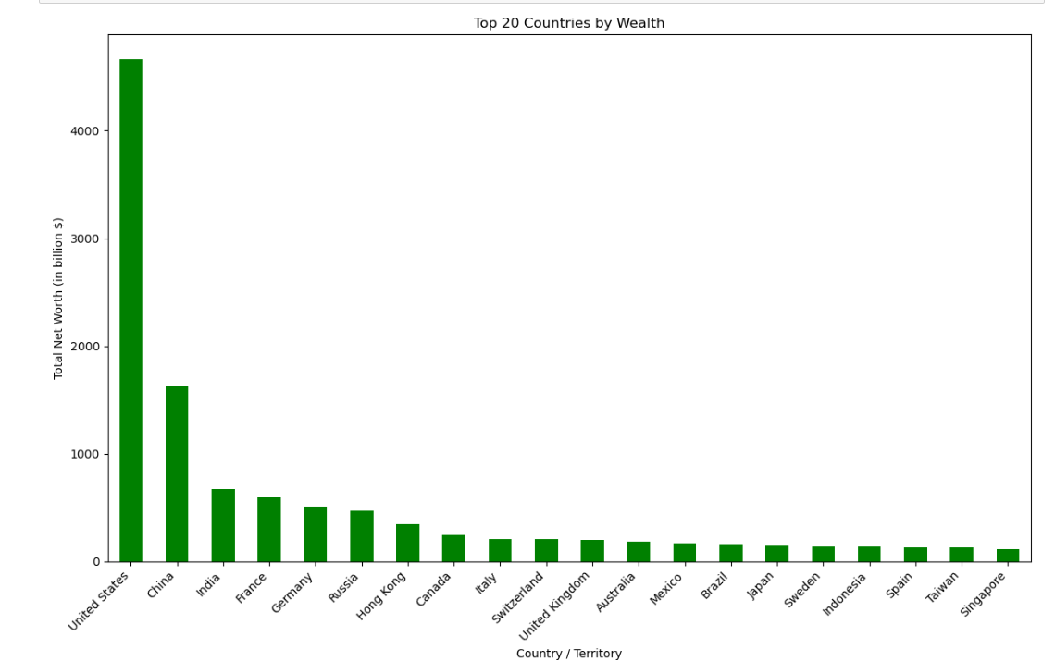
Top 20 Countries by Billionaire Wealth
The distribution of billionaire wealth is heavily concentrated in a relatively small number of countries.
The United States holds a dominant position with the highest billionaire wealth, reflecting its robust economy.

Slide 9
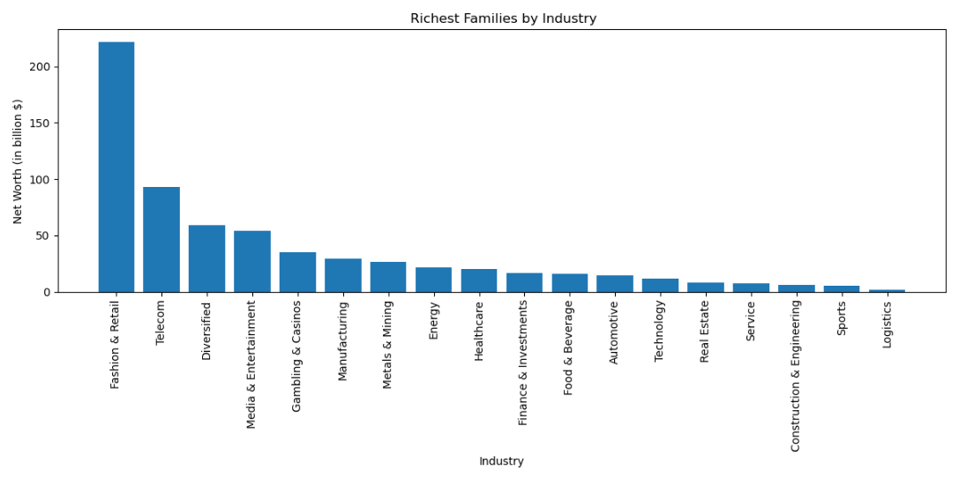
Industries Elevating 324 Families to Billionaire Status
Fashion and Retail, Telecom, Diversified, Media & Entertainment and Gambling & Casino rank as the top 5 industries with high elevation power.

Slide 10
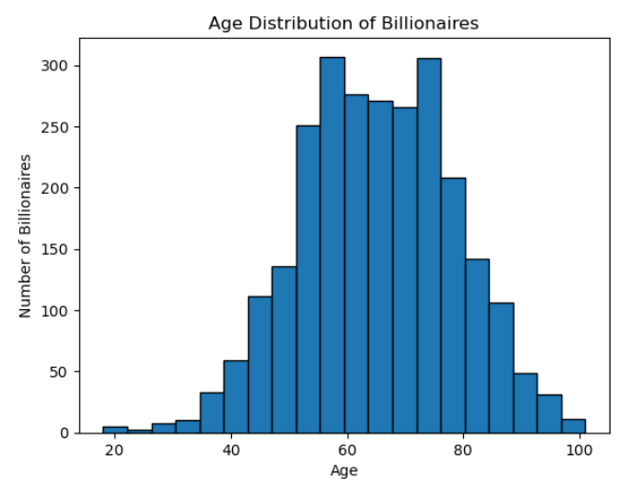
Age Distribution of Billionaires
The age distribution of billionaires reveals a wide range of representation.
This distribution underscores the potential for wealth creation across different life stages.

Slide 11
CONCLUSION
Industry Influence
Global Diversity
Age vs. Net Worth
Future Insights
Call for Action

Slide 12
THANK YOU

